Slide 1
Function Overloading; Inline functions
13 SEP 2022

Slide 2
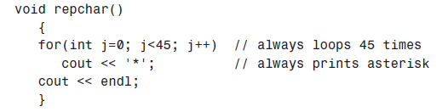
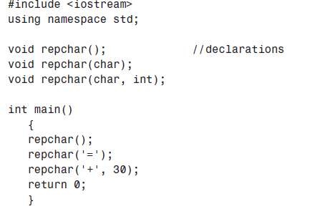
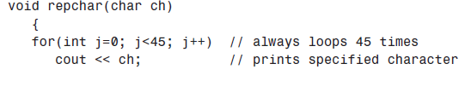

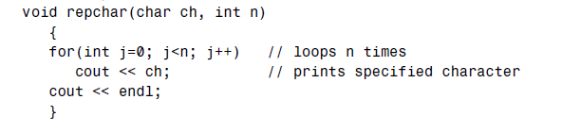
Overloaded Functions -Many functions with same name but with different signatures.
perform different activities depending on the kind of data sent to it.
It performs one operation on one kind of data but another operation on a different kind
In Function Overloading “Function” name should be the same and the arguments should be different.
Different Numbers of Arguments

Slide 3
Output
*********************************************
=============================================
++++++++++++++++++++++++++++++

Slide 4
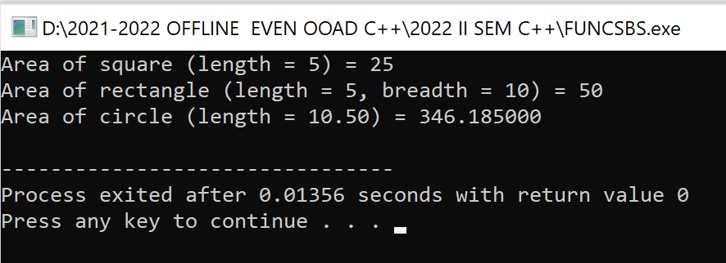
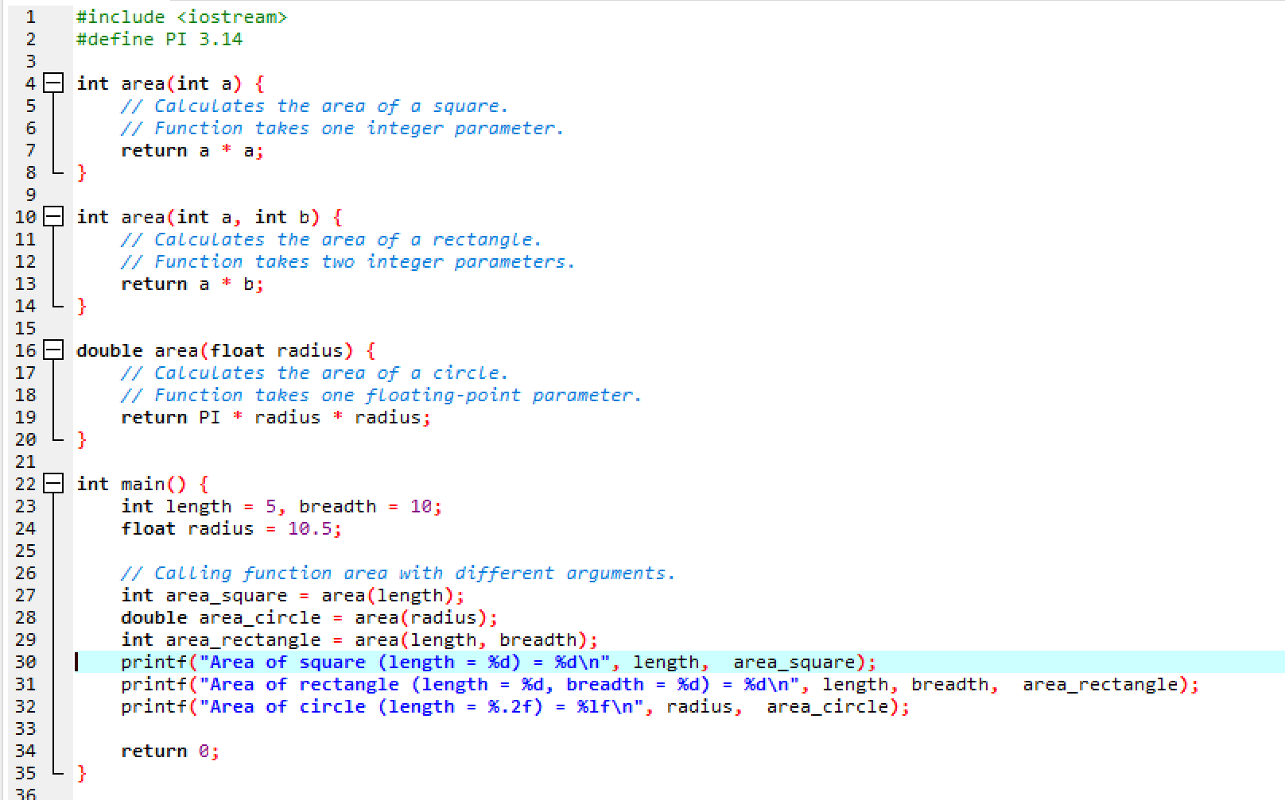
Many functions with same name but with different signatures.

Slide 5
Overloading Using Different Number of Parameters
#include <iostream>
using namespace std;
// function with 2 parameters
void display(int var1, double var2) {
cout << "Integer number: " << var1;
cout << " and double number: " << var2 << endl;
}
// function with double type single parameter
void display(double var) {
cout << "Double number: " << var << endl;
}
// function with int type single parameter
void display(int var) {
cout << "Integer number: " << var << endl;
}
int main() {
int a = 5;
double b = 5.5;
// call function with int type parameter
display(a);
// call function with double type parameter
display(b);
// call function with 2 parameters
display(a, b);
return 0;
}

Slide 6
Different Kinds of Arguments
The compiler can also distinguish between overloaded functions with the same number of arguments, provided their type is different.
#include <iostream>
using namespace std;
float absolute(float var){
if (var < 0.0)
var = -var;
return var;
}
int absolute(int var) {
if (var < 0)
var = -var;
return var;
}
int main() {
cout << "Absolute value of -5 = " << absolute(-5) << endl;
cout << "Absolute value of 5.5 = " << absolute(5.5f) << endl;
return 0;
}
Output
Absolute value of -5 = 5
Absolute value of 5.5 = 5.5
Overloaded functions can simplify the programmer’s life by reducing the number of function names to be remembered
abs() for type int
fabs() for type double
labs() for type long.
In C++, a single name, abs(), would suffice for all these data types

Slide 8
Inline Functions
To save execution time in short functions, you may elect to put the code in the function body
directly inline with the code in the calling program
Each time there’s a function call in the source file, the actual code from the function is inserted, instead of a jump to the function
keyword inline in the function definition

Slide 9
#include <iostream>
using namespace std;
inline float lbstokg(float pounds)
{
return 0.453592 * pounds;
}
int main()
{
float lbs;
cout << “\nEnter your weight in pounds: “;
cin >> lbs;
cout << “Your weight in kilograms is “ << lbstokg(lbs)
<< endl;
return 0;
}
inline keyword is actually just a request to the compiler.
Sometimes the compiler will ignore the request and compile the function as a normal function

Slide 10
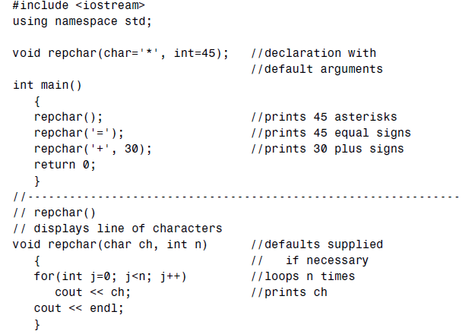
Default Arguments
a function can be called without specifying all its arguments.
The function declaration must provide default values for those arguments
that are not specified.
that missing arguments must be the trailing arguments—those at the end of the argument list

Slide 11
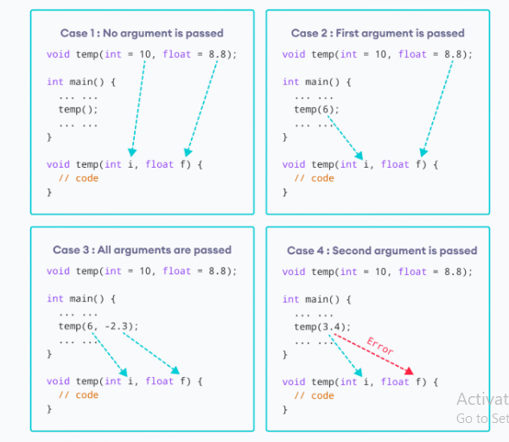

Slide 12
Once we provide a default value for a parameter, all subsequent parameters must also have default values
2. If we are defining the default arguments in the function definition instead of the function prototype, then the function must be defined before the function call.

